Slide 1






THE SPARKS FOUNDATION
NON TECHNICAL TASKS
CONTENT DEVELOPMENT & DIGITAL MARKETING TASKS
by ANIUBHA GAJARGAONKAR

Slide 2



#TASK 4 -POSTER DESIGN

Slide 3



Slide 4





Slide 5

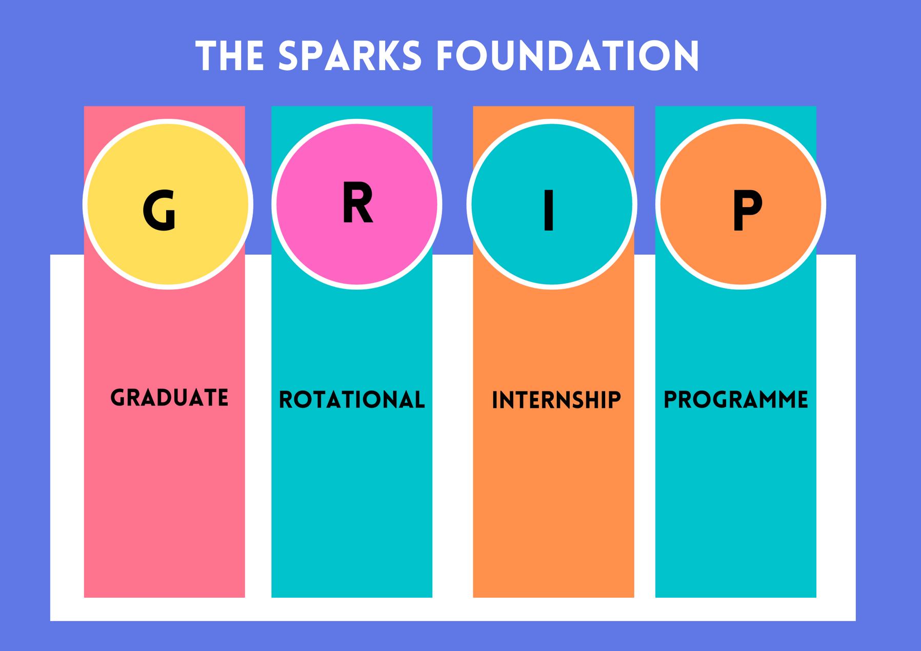


Slide 6
Thank You

